Slide 1
Data-Oriented (and Beyond) Network Architecture
Article from 2007 SIGCOMM conference
Presented by Vilen Looga, M.Sc.
DCS Lab
Aalto University School of Science

Slide 2
Reference material
Teemu Koponen, Mohit Chawla, Byung-Gon Chun, Andrey Ermolinskiy, Kye Hyun Kim, Scott Shenker, and Ion Stoica. 2007. A data-oriented (and beyond) network architecture. SIGCOMM Comput. Commun. Rev. 37, 4 (August 2007)
2/28

Slide 3
Outline
Introduction
Basic design
Using DONA’s basic functionality
Extending DONA
Implementation
Feasibility
Broader Architectural Implications
Discussion
3/28

Slide 4
Introduction
Currently DNS name resolution system has limited in role over the Internet architecture, mostly for historical reasons
Clean slate design for naming and name resolution, with a shift from host-centric to data centric applications in mind
4/28

Slide 5
Introduction
Consider the following issues:
Persistence – once a data or service object exists, the users require access even if the host has changed
Availability – Low-latency and high availability are important requirements, but currently served by ad hoc solutions
Authenticity – Explicit authentication of data vs. (typical) secure channel to the source
5/28

Slide 6
Introduction
Proposal:
Flat, self-certifying names
Name-based anycast primitive above IP layer
6/28

Slide 7
Basic Design – Motivation
Strict separation of concerns:
Names handle persistence and authenticity: data is not tied to a host; signature verifies data
Name resolution handles availability: guiding requests to the nearest copy of data; avoiding unavailable servers.
Out of scope:
Trustworthiness of the source: authors chose to leave it outside of their proposed architecture and instead suggest approaches such as reputation systems and “web-of-trust” (OpenPGP)
7/28

Slide 8
Basic Design – Naming
A Internet actor’s, principal’s, identity is tied to public-private key pair
A named entity (domain, host, web page, part of web page) is tied to a principal
Names in the form P:L, where:
P -> cryptogr. hash of public key
L -> label; hash, in case of immutable data (CDN)
Principal authorizes hosts to serve data
Each piece of information is signed by the principal (and his key authority, if necessary)
Issue: how can user’s remember these flat names?
External mechanisms: Google, FB?
Private database of human readable names?
.. in any case, mapping becomes an issue of trust between a user and a principal, rather than name lookup for administrative structure
8/28

Slide 9
Basic Design – Name resolution
Route-by-name instead of lookup-by-name, with the help of Resolution Handlers (RH)
Each domain or entity X has one logical RH_{X,} which can have many physical incarnations
One RH can act as others peer/child/parent, with the corresponding reverse role of the other RH
Each client connects to one logical RH using local configuration (DHCP?)
Switching providers would be a simple operation of authorizing new provider
9/28

Slide 10
Basic Design – Name resolution
FIND(P:L) – client requests for object P:L and RH requests to a nearby copy
FIND(*:L) – immutable data; client is willing to accept self-certified data from any provider
REGISTER(P:L) – P registers at it’s local RH
REGISTER(P:*) – RH can serve all the data from P
10/28

Slide 11
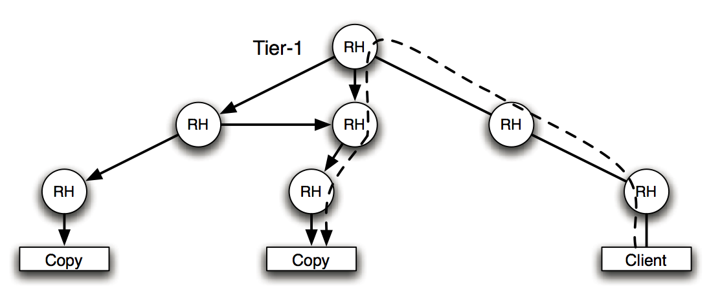
Basic Design – Name resolution
11/28

Slide 12
Basic Design – Security Issues
DoS attacks should be handled on IP layer
Peering RHs exchange their public keys to ensure that they are receiving packets from the right source
No key revocation mechanism in DONA, blacklist should be provided by third parties
Principals can check if their key is already in use by issuing FIND(P:*) message
12/28

Slide 13
Basic Design – Internet Addressing
Crisis in the Internet addressing scheme?
Authors suggest using path labels:
Each host has a domain specific local address, which is meaningless outside of that domain
When client sends a FIND, each host on the route appends next-hop instructions
Server reverses path instructions to send a response
No per-flow state in the network (unlike NNC)
13/28

Slide 14
Functionality – Server selection
A CDN would use several servers authorized to provide P:L datum:
How does the client choose one? Latency?
In a P2P network data can be broken into indexed chunks which client can request with FIND(*:L)
After receiving data client can register to serve L at his RH
14/28

Slide 15
Functionality – Mobility and Multihoming
A mobile host must unregister from one location and re-register at another
Multihomed hosts can register at several local RH
Multihomed domain forwards REGISTER messages to each provider
15/28

Slide 16
Functionality – Session Initiation
Rendezvous mechanism similar to SIP
SIP INVITE = DONA FIND
SIP REGISTER = DONA REGISTER
More on that later
16/28

Slide 17
Functionality – Multicast State Establishment
DONA’s anycast primitive can be used for tree discovery
A domain border router with members of multicast group P:G, where P is the group originator
When a new node joins P:G, its border router R_{new} sends FIND(P:G) to neighbor R.
If R has members in P:G it adds R_{new} to overlay topology and both update their P:G table of neighbors
R_{new} send REGISTER(P:G) and starts serving as attachment point for P:G
17/28

Slide 18
Extending DONA – Content Delivery
Caching – RH can change the source IP address of incoming FIND packets, so that the response will traverse them and they can cache it
solved in path label IA?
Subscriptions – using cached TTL’ed FIND packets, ensures that the RH will send updated content to the FIND source
Problematic servers – clients can modify the FIND request to access kth server, rather than the closest one
18/28

Slide 19
Extending DONA – DTN
Delay-Tolerant Networking works on the principle of message custody transfer: intermediate entity’s are responsible to ensure forwarding of the message
RHs in DONE could act as intermediaries similarly to how RH behaves when caching responses to FIND
19/28

Slide 20
Extending DONA – Access rules and middleboxes
There is no support for middleboxes and acces rules in the current architecture
RH can have meaningful policies when receiving FIND:
Drop it like its hot
Return error code
Ask for authentication
RHs can provide capabilites on per-domain basis inserted into FIND packets (path labels for a more general approach)
Middlebox insertion in DONA (see next picture)
20/28

Slide 21
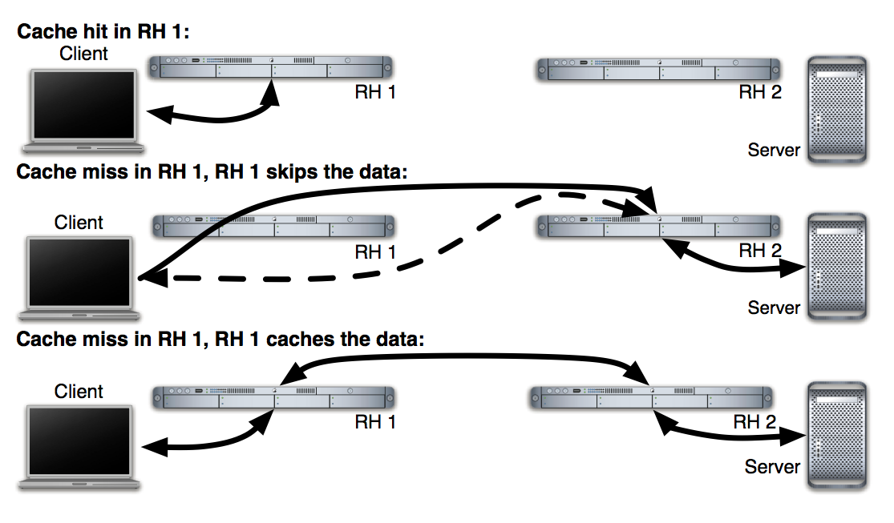
Extending DONA – Access rules and middleboxes (Example)
21/28

Slide 22
Implementation
RH prototype as a Java deamon that sits between transport and IP layer
Implemented several modules in Linux:
Router module – processes incoming REGISTER and FINDS; routes FINDS; monitors liveness of neighbors etc.
Caching module – offers application modules access to a local cache
Application modules – HTTP, SIP, P2P, RSS
22/28

Slide 23
Feasibility – Requirements
RHs of Tier-1 providers must maintain registration items for all items in the Internet
Total storage = 10¹¹ items x 42 bytes per entry = 4 TB
Assuming 83000 REGISTER messages per second per Tier-1 RH, each needing cryptogr. operations, load could be handled by 40 CPU (or less assuming trust between peering ASs)
Assuming 20k FIND requests per second per RH, 500 CPUs should suffice
23/28

Slide 24
Feasibility – design of RH infrastructure
Tier-1 AS RH infrastructure
Master RH to receive and store registrations, and disseminate to its peers
Several Cache RH (with the help of cooperative caching, to increase hit rate) to route FINDs from customers, which in case of a failure is sent up to the Master RH
In case of Cache RH failure, it boots up and start repopulating its cache as messages arrive
In case of Master RH failure, it has to re-sync with it’s neighbors
24/28

Slide 25
Broader Architectural Implications
Data-oriented architecture allows applications protocols to be oriented around application objects, rather than bytes
DONA would raise the level of abstraction on application level, shielding apps from low-level communication problems
DONA message propagation mechanism could be suitable for DTNs
Data-oriented application interface is similar to Pub/Sub approach, by decoupling end-points in time and space
25/28

Slide 26
Discussion
Comparison to ROFL?
Less complex operations
No need to route traffic through neighbors (Chord)
Comparison to NNC?
No built-in protection against DDoS attacks
Is it viable?
26/28

Slide 27
References
Teemu Koponen, Mohit Chawla, Byung-Gon Chun, Andrey Ermolinskiy, Kye Hyun Kim, Scott Shenker, and Ion Stoica. 2007. A data-oriented (and beyond) network architecture. SIGCOMM Comput. Commun. Rev. 37, 4 (August 2007)
Matthew Caesar, Tyson Condie, Jayanthkumar Kannan, Karthik Lakshminarayanan, and Ion Stoica. 2006. ROFL: routing on flat labels. SIGCOMM Comput. Commun. Rev. 36, 4 (August 2006)
OpenPGP: http://tools.ietf.org/html/rfc4880
Mark Handley and Adam Greenhalgh. 2004. Steps towards a DoS-resistant internet architecture. In Proceedings of the ACM SIGCOMM workshop on Future directions in network architecture (FDNA '04). ACM, New York, NY, USA, 49-56
SIP: http://tools.ietf.org/html/rfc3261
Xiaowei Yang, David Wetherall, and Thomas Anderson. 2005. A DoS-limiting network architecture. SIGCOMM Comput. Commun. Rev. 35, 4 (August 2005)
Patrick Th. Eugster, Pascal A. Felber, Rachid Guerraoui, and Anne-Marie Kermarrec. 2003. The many faces of publish/subscribe. ACM Comput. Surv. 35, 2 (June 2003), 114-131.
27/28

Slide 28
Thank you!

